Slide 1
Design Patterns Part-1

Slide 2
Table of Contents
Introduction to Design Patterns:
What's a Design Pattern?
Why Should I Learn Patterns?
Types of Design Patterns
Prerequisites for Learning Design Patterns
OOP
Software Design Principles
SOLID Principles
Introduction to OOP
Basics of OOP
Pillars of OOP
Relations Between Objects
Software Design Principles
Features of Good Design
Design Principles
SOLID Principles
Notes:
You can hide it OR move forward quickly

Slide 3
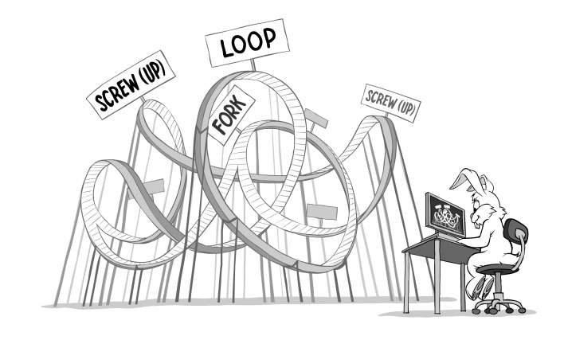
Introduction to Design Patterns
Notes:
Here just hear from them what they know about Design patterns; if they know any patterns before i.e Singleton, .. (~5 mins)

Slide 4
What’s a Design Pattern?
Design patterns: are typical solutions to commonly occurring problems in software design. They are like pre-made blueprints that you can customize to solve a recurring design problem in your code.
Design Patterns vs Algorithms ??
High-level description of a solution vs Clear set of actions to achieve solution
Notes:
Let them try to answer first the difference bet Algorithm and DP.. An algorithm always defines a clear set of actions that can achieve some goal, a pattern is a more high-level description of a solution. The code of the same pattern applied to two different programs may be different.

Slide 5


Why Should I Learn Patterns?
Truely, you can WORK without it at your
first years of SW Development career!
BUT you should learn it as:
You WON’T be able to WORK without them!
Notes:
The truth is that you might manage to work as a programmer for many years without knowing about a single pattern. A lot of people just do. Even in that case, though, you might be implementing some patterns without even knowing it.
So, Why should we spend time then learning them?? - next slide

Slide 6
Why Should I Learn Patterns?
Design patterns are a toolkit of tried and tested solutions to common problems in software design you should be familiar
Design patterns define a common language that you and your teammates can use to communicate more efficiently
I.e Let’s implement Singleton instead of describing what it does
Notes:
Design patterns are a toolkit of tried and tested solutions to common problems in software design. Even if you never encounter these problems, knowing patterns is still useful because it teaches you how to solve all sorts of problems using principles of object-oriented design.
Design patterns define a common language that you and your teammates can use to communicate more efficiently. You can say, “Oh, just use a Singleton for that,” and everyone will understand the idea behind your suggestion. No need to explain what a singleton is if you know the pattern and its name.

Slide 7
Types of Design Patterns
Pattern consists of:
Intent of the pattern briefly describes both the problem and the solution.
Motivation further explains the problem and the solution the pattern makes possible.
Structure shows how the various components (such as classes or objects) in the pattern are related to each other.
Code example in one of the popular programming languages makes it easier to grasp the idea behind the pattern.

Slide 8
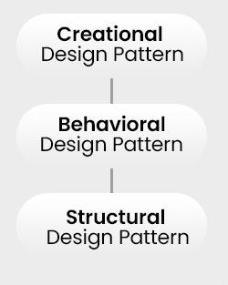
Types of Design Patterns
Creational:
Objects creation mechanisms
Structural:
Objects assemble in large structures
Behavioral:
Objects communication effectively
Notes:
Don’t explain any of them in details..

Slide 9
Prerequisites for Learning Design Patterns
Since Design Patterns deals with Objects and the best way they are designed and structured!
We need to learn/remember very well:
OOP (Object Oriented Programming)
Software Design Principles
SOLID Principles

Slide 10
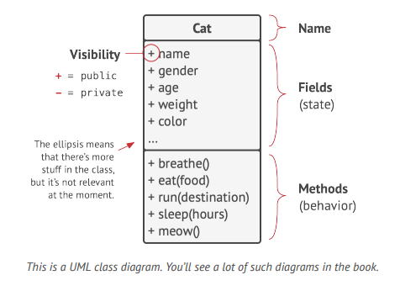
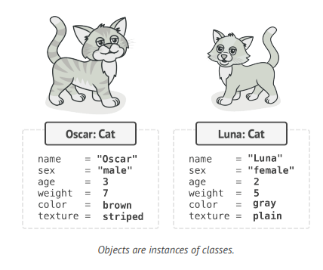
Basics of OOP
Classes -> Abstract Contract Objects -> Instance

Slide 11
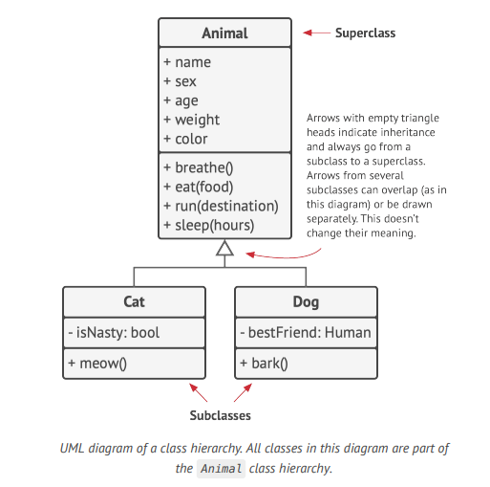
Class hierarchies
Superclass (Parent class)
Subclasses (Child/Derived class)

Slide 12
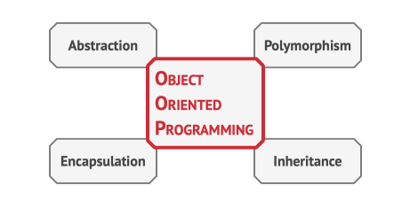
Pillars of OOP
Notes:
4 Main Pillars

Slide 13
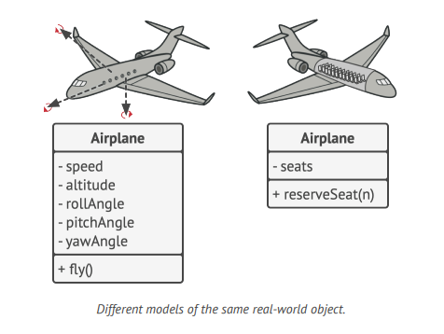
Pillar 1: Abstraction
It is model of an Object
limited to Specific context.
Notes:
Abstraction is a model of a real-world object or phenomenon, limited to a specific context, which represents all details relevant to this context with high accuracy and omits all the rest.
In this example we want to represent an “airplane”.
The left side represents it in a flight simulator for example so we need the speed, the angles , ..
The right side represents it in a airport / airplane tickets application

Slide 14
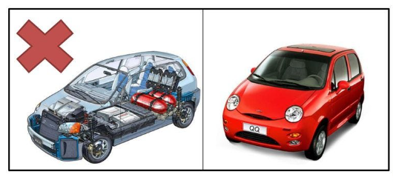
Pillar 2: Encapsulation
Hide the details of implementation. Just give interface to what are needed.
Notes:
To start a car engine, you only need to turn a key or press a button. You don’t need to connect wires under the hood, rotate the crankshaft and cylinders, and initiate the power cycle of the engine. These details are hidden under the hood of the car. You have only a simple interface: a start switch, a steering wheel and some pedals. This illustrates how each object has an interface—a public part of an object, open to interactions with other objects.

Slide 15
Pillar 3: Inheritance
Inheritance is the ability to build new classes (child classes) on top of existing ones (parent classes). The main benefit of inheritance is code reuse.
BUT, the problem with it, is that subclasses have the same interface as their parent class. SO, you must also implement all abstract methods, even if they don’t make sense.
Notes:
Inheritance is the ability to build new classes on top of existing ones. The main benefit of inheritance is code reuse.
The consequence of using inheritance is that subclasses have the same interface as their parent class. You can’t hide a method in a subclass if it was declared in the superclass. You must also implement all abstract methods, even if they don’t make sense for your subclass.

Slide 16
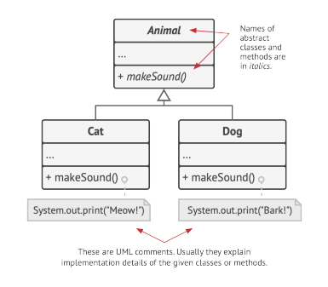
Pillar 4: Polymorphism
Polymorphism: It is an ability of
object to behave in multiple
form. It allows us to perform
a single action in different ways.
Notes:
Polymorphism is the ability of a program to detect the real class of an object and call its implementation even when it's real type is unknown in the current context.
You can also think of polymorphism as the ability of an object to “pretend” to be something else, usually a class it extends or an interface it implements. In our example, the dogs and cats in the bag were pretending to be generic animals

Slide 17
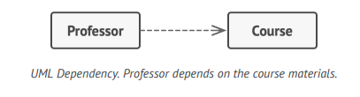
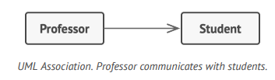
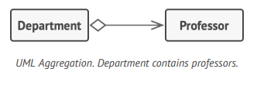
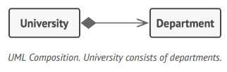
Relations Between Objects
• Dependency: Class А can be affected by changes in class B. (Car & Fuel Type)
• Association: Object А knows about object B. Class A depends on B. (Car & Driver)
• Aggregation: Object А knows about object B, and consists of B. Class A depends on B. (Library & Books)
• Composition: Object А knows about object B, consists of B, and manages B’s life cycle. Class A depends on B. (Car & Car Body)
Notes:
Dependency is the most basic and the weakest type of relations between classes. There is a dependency between two classes if some changes to the definition of one class might result in modifications to another class.
Association is a relationship in which one object uses or interacts with another.
Aggregation is a specialized type of association that represents “one-to-many”, “many-to-many” or “whole-part” relations between multiple objects.
Composition is a specific kind of aggregation, where one object is composed of one or more instances of the other. The distinction between this relation and others is that the component can only exist as a part of the container

Slide 18
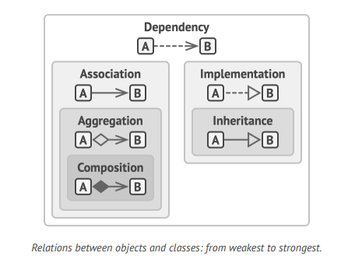
Relations Between Objects Cont.
• Implementation: Class А defines methods declared in interface B. Objects A can be treated as B. Class A depends on B.
• Inheritance: Class А inherits interface and implementation of class B but can extend it. Objects A can be treated as B. Class A depends on B.
Notes:
Inheritance represents the “is a” relationship between classes (a car is a vehicle), composition represents the “has a” relationship (a car has an engine)
Implementation:
from abc import ABC, abstractmethod
class Animal(ABC): # Interface (abstract class in Python)
@abstractmethod
def speak(self):
pass
class Dog(Animal): # Class A implements Interface B
def speak(self):
return "Bark"
dog = Dog()
print(dog.speak()) # Outputs: "Bark"
Inheritance: class Vehicle: # Class B
def move(self):
return "Vehicle is moving"
class Car(Vehicle): # Class A inherits from B
def move(self):
return "Car is moving fast" # Overriding the method
car = Car()
print(car.move()) # Outputs: "Car is moving fast"

Slide 19
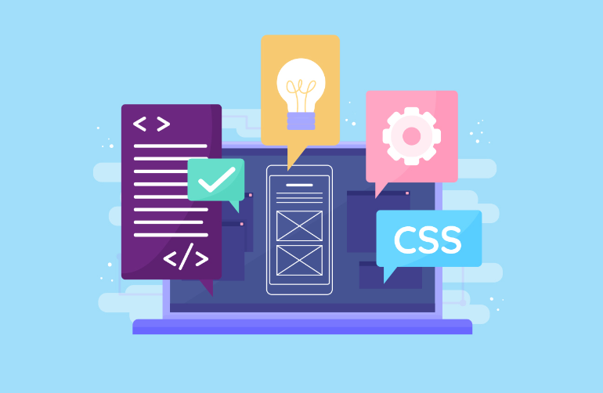
Software Design Principles
Features of Good Design:
Code reuse
Extensibility

Slide 20
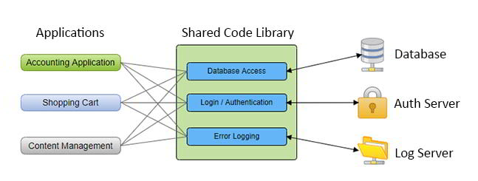
Features of Good Software Design
1. Code Reuse:
It looks easy right? BUT, it turns out that making existing/shared code work in a new context usually takes extra effort. WHY?
Using design patterns is one way to increase flexibility of software components and make them easier to reuse.
Notes:
Code reuse is one of the most common ways to reduce development costs. The intent is pretty obvious: instead of developing something over and over from scratch, why don’t we reuse existing code in new projects?
The idea looks great on paper, but it turns out that making existing code work in a new context usually takes extra effort.
[TA] Due to Tight coupling between components, dependencies on concrete classes instead of interfaces, hardcoded operations—all of this reduces flexibility of the code and makes it harder to reuse it.

Slide 21
Features of Good Software Design
2. Extensibility:
Change is the only constant thing in a programmer’s life.
We want to extended our program with new functionality without needing to make significant changes to the existing codebase.
Bugs
New features
Enhancing old features
There’s a bright side: if someone asks you to change something in your app, that means someone still cares about it

Slide 22
Design Principles
1. Encapsulate What Varies
Identify the aspects of your application that vary and separate them from what stays the same.
Notes:
At first ask what you expect from the headline “Encapsulate What Varies” ?
Read definition and explain the problem in the next slide Note this principle will be used in the SOLID ⇒ S → single responsibility

Slide 23
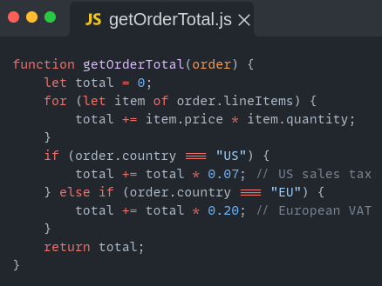
Design Principles
What is the problem here?
Notes:
This function calculate total cost for the order and calculate tax

Slide 24
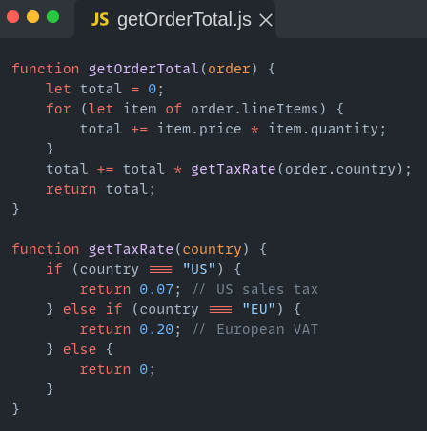
Design Principles
Encapsulation on a method level
Notes:
That is an example for single responsibility 3ala level el functions , in the next slide there is an example 3ala class level

Slide 25
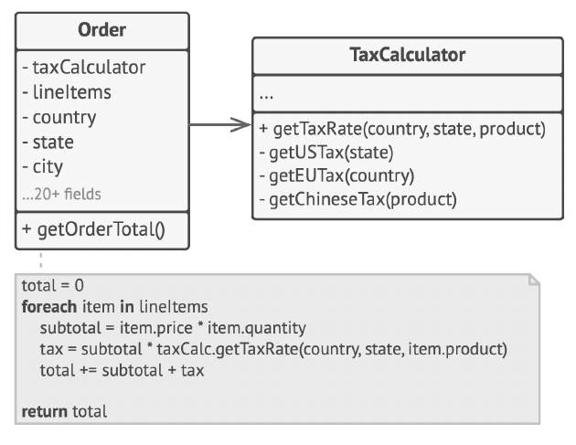
Design Principles
Encapsulation on a class level

Slide 26
Design Principles Cont.
2. Program to an Interface, not an Implementation
Program to an interface, not an implementation. Depend on abstractions, not on concrete classes.
Notes:
The goal is to decouple your code from specific implementations, making it easier to change or extend later.

Slide 27
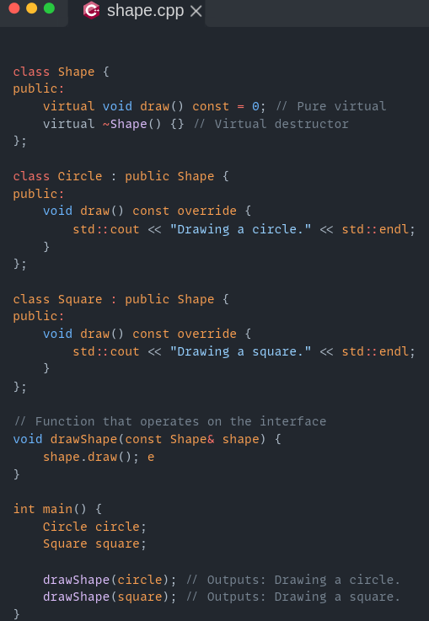
Design Principles Cont.
Remember Polymorphism

Slide 28
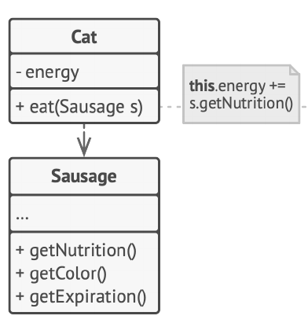
Design Principles Cont.
What is the problem here?
Notes:
Cat depends on concrete class sausage (tightly coupled)

Slide 29
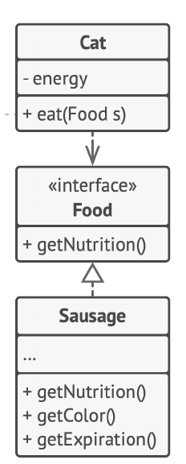
Design Principles Cont.
1- Determine what exactly one object needs from the other: which methods does it execute?
2- Describe these methods in a new interface or abstract class.
3- Make the class that is a dependency implement this interface.
4- Now make the second class dependent on this interface rather than on the concrete class.

Slide 30
Design Principles Cont.
3. Favor Composition Over Inheritance
Build your classes like Lego blocks, using small pieces that do specific jobs, instead of one big block that tries to do everything.

Slide 31
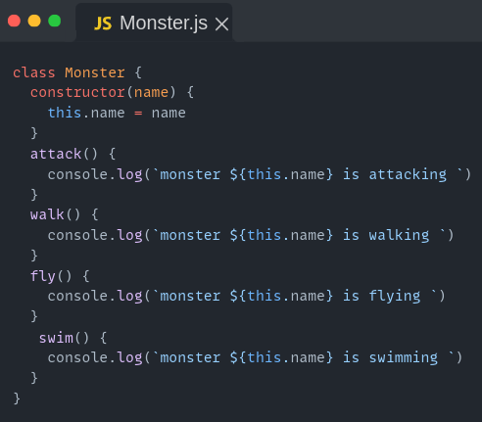
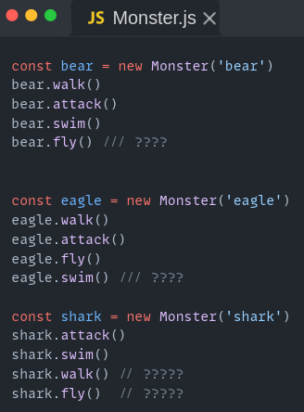
Design Principles Cont.

Slide 32
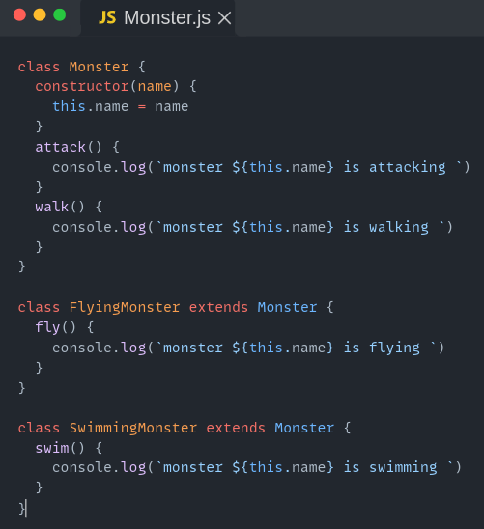
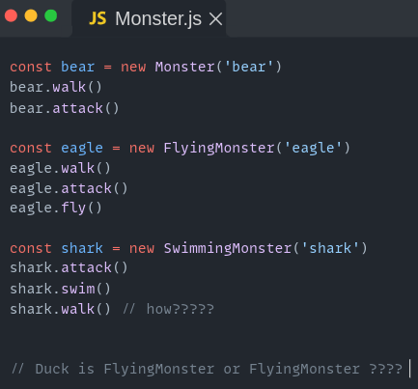
Design Principles Cont.

Slide 33
Design Principles Cont.
Problems
1- A subclass can’t reduce the interface of the superclass.
2- There are multiple combinations to build class.

Slide 34
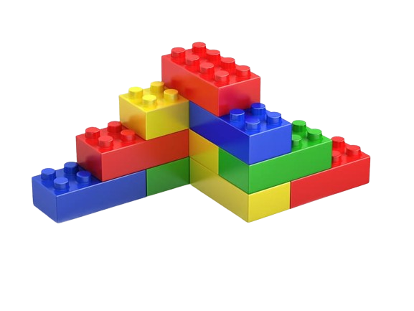
Design Principles Cont.
Composition

Slide 35
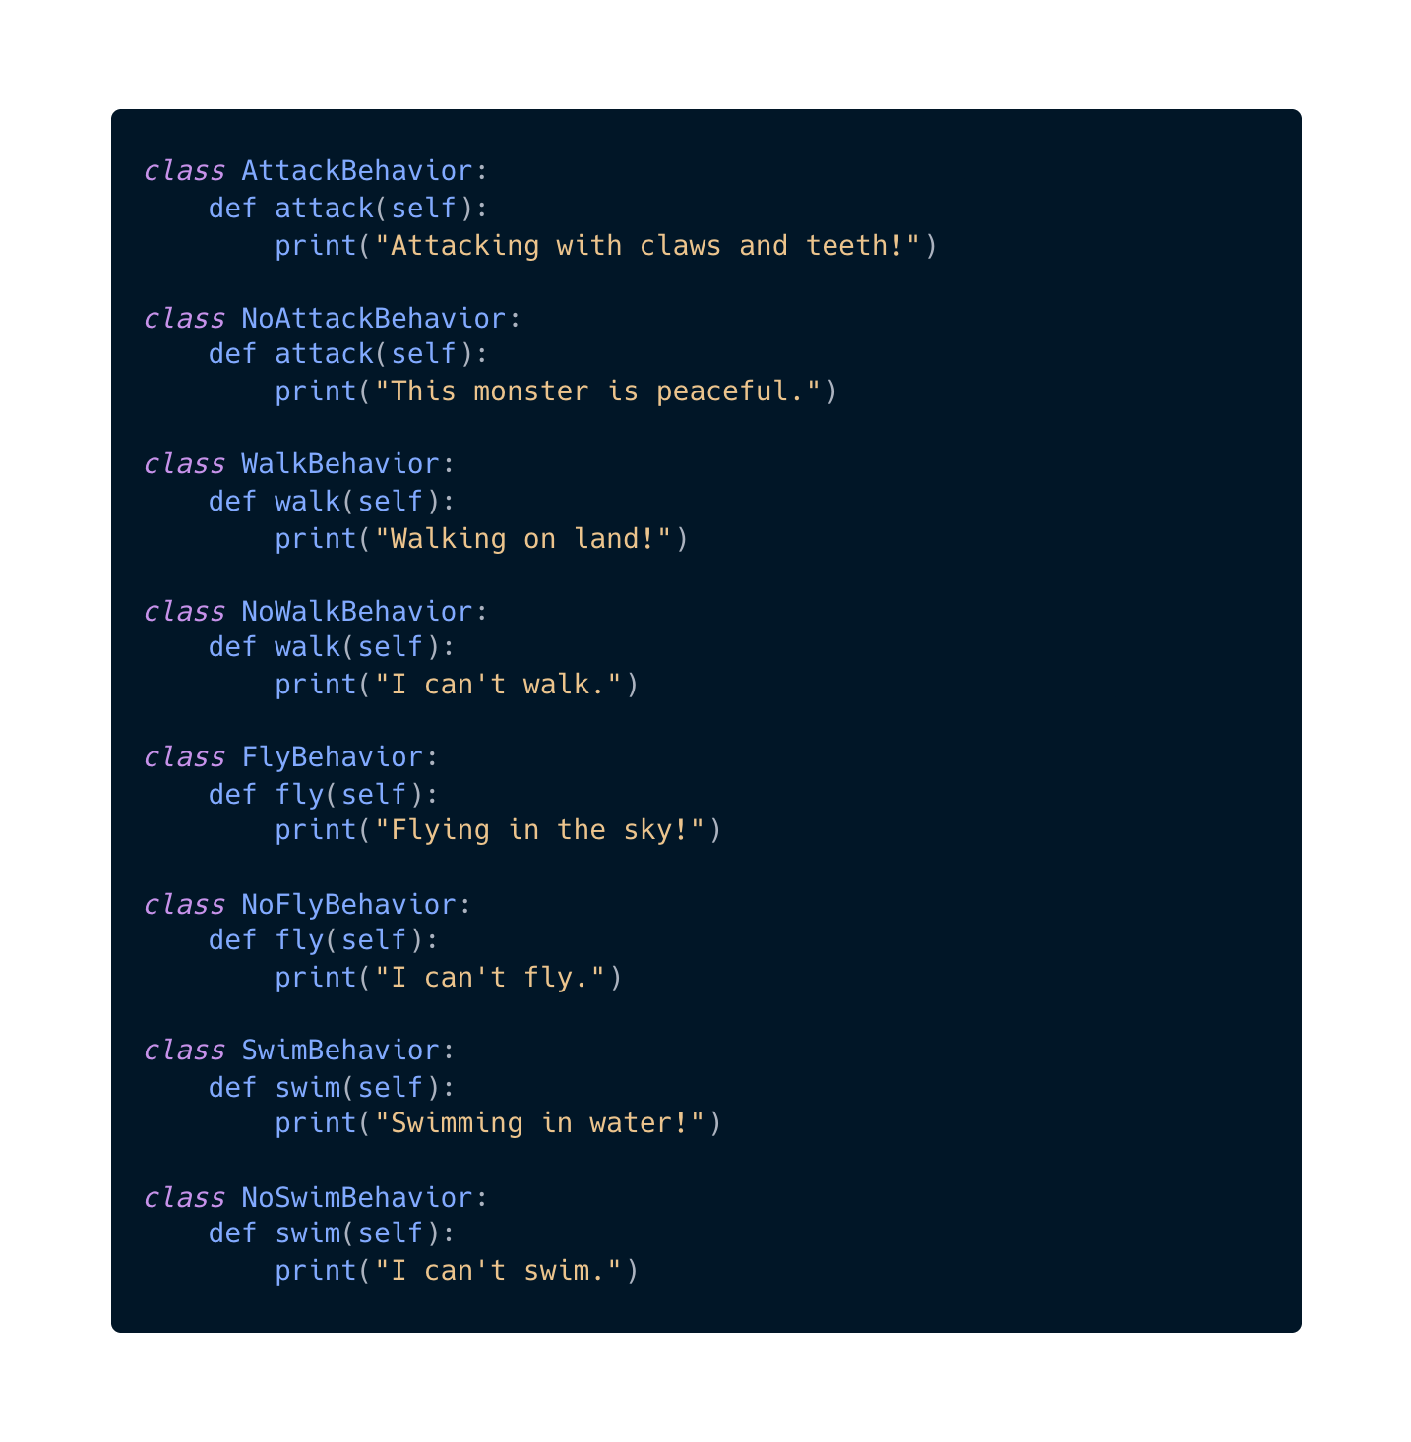
Step 1:
Define Behaviors

Slide 36
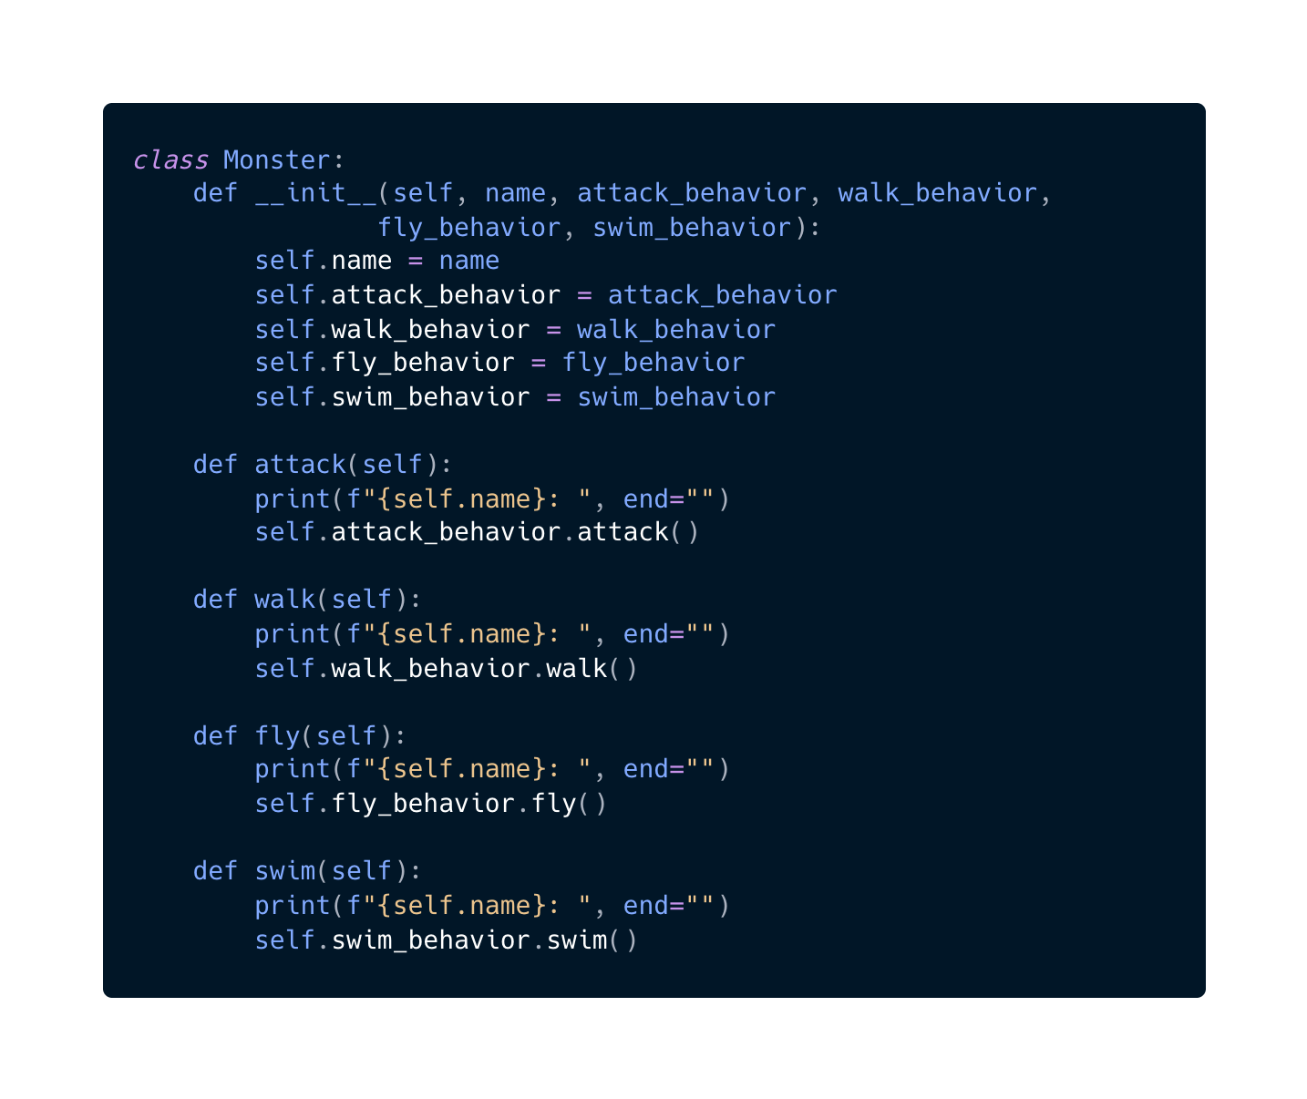
Step 2:
Define the Monster
Class

Slide 37
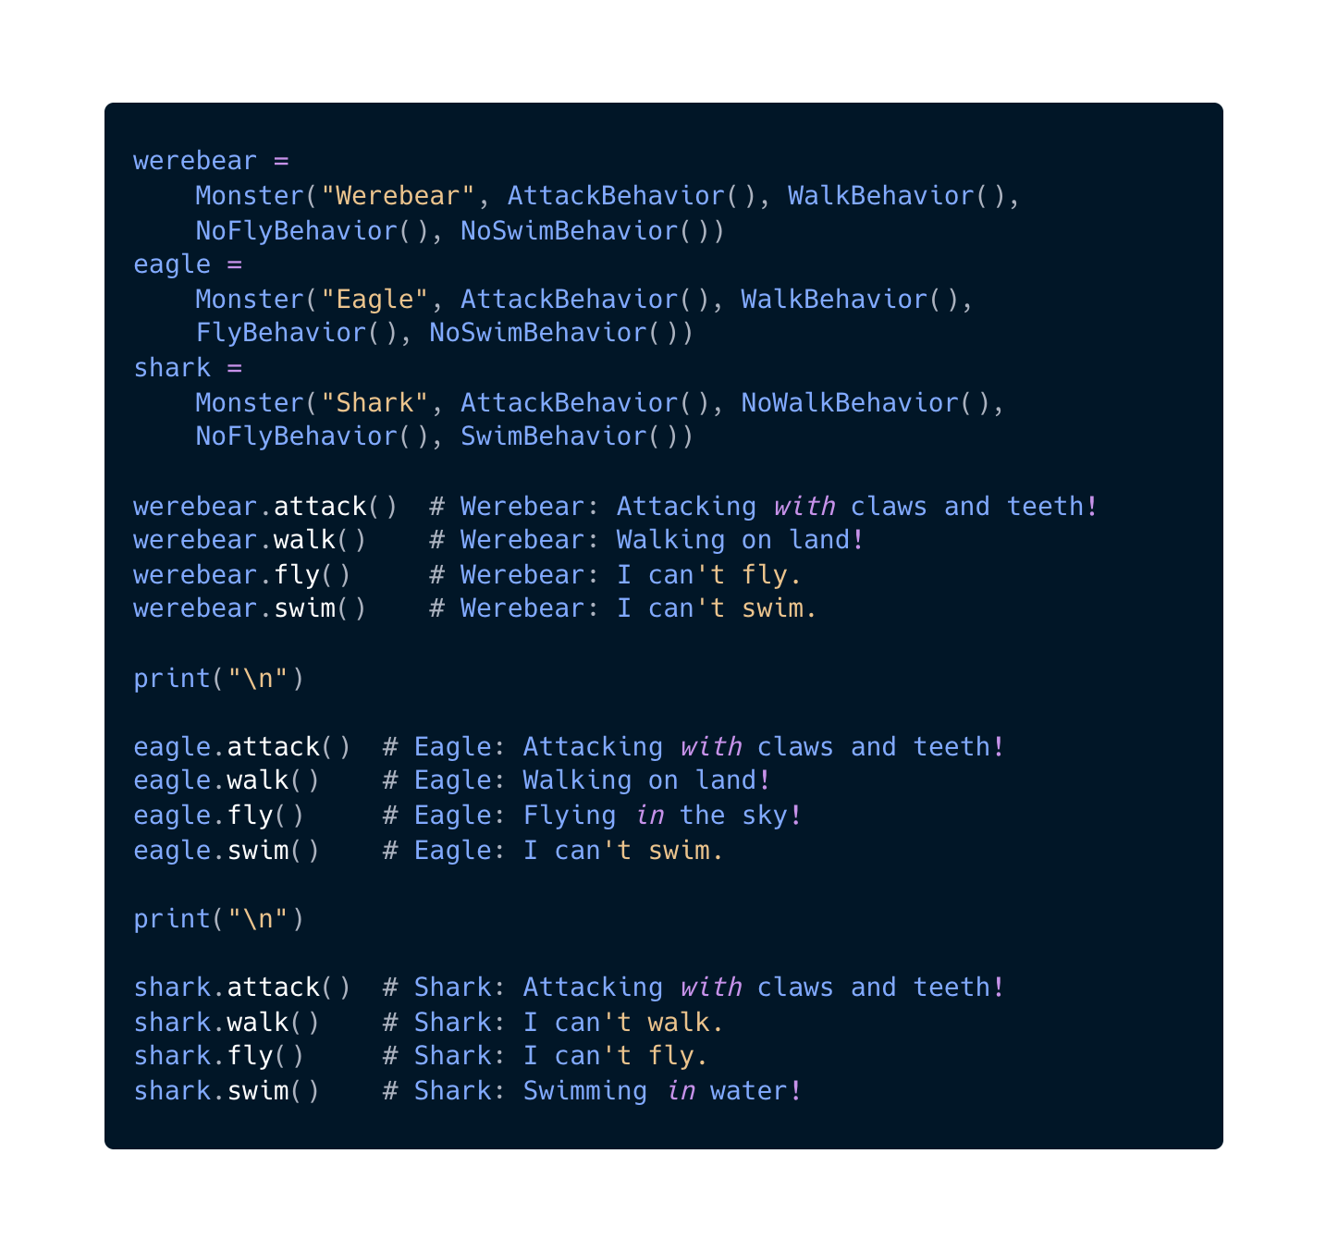
Step 3:
Create Monsters
& Test

Slide 38
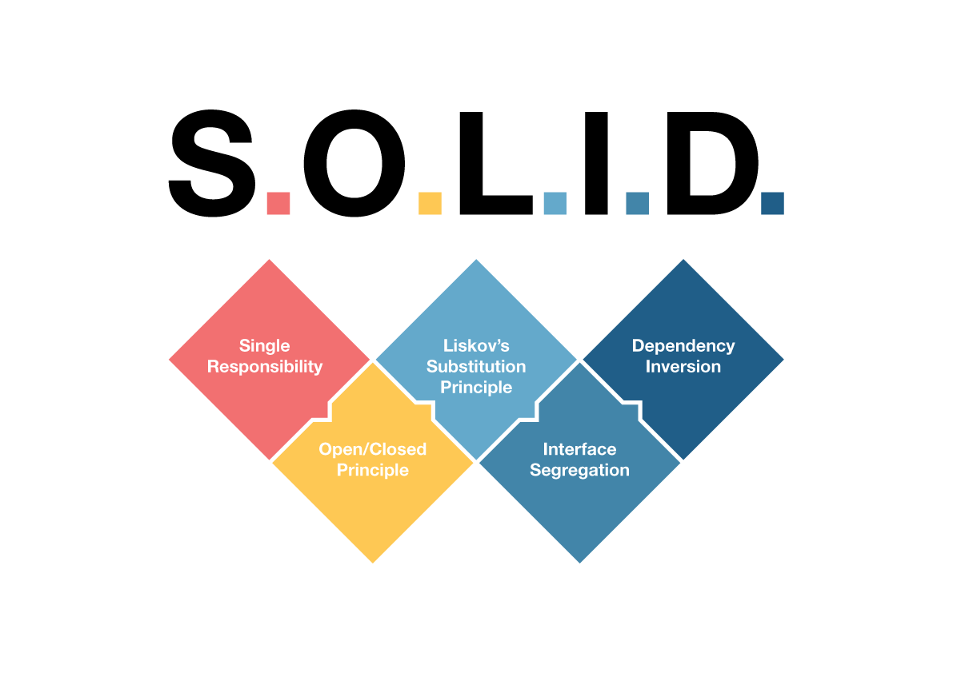
SOLID Principles
Notes:
Set of design principles specifically tailored to object-oriented programming (OOP).

Slide 39
Single Responsibility Principle
"A module should be responsible to one, and only one, actor."
A class should have just one reason to change.
Notes:
meaning it should have only one job or responsibility

Slide 40
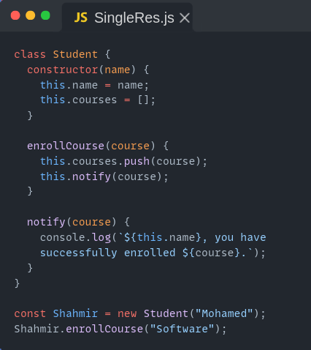
Single Responsibility Principle
What is the problem here?
Notes:
The class has 2 reasons to change:
if we want to change how we're enrolling in the course
if we want to change how we notify the user

Slide 41
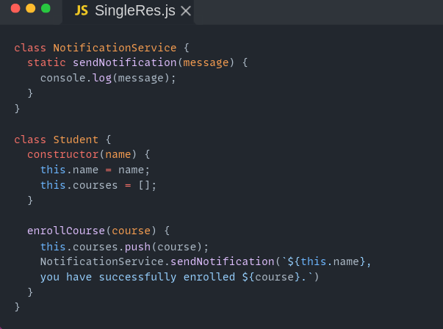
Single Responsibility Principle

Slide 42
Open / Closed Principle
Classes should be open for extension but closed for
modification.

Slide 43
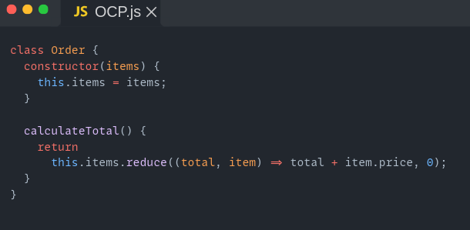
Open / Closed Principle
Add discount on order

Slide 44
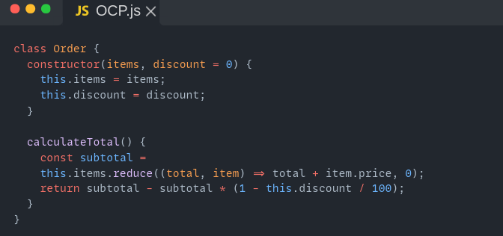
Open / Closed Principle
Violate OCP

Slide 45
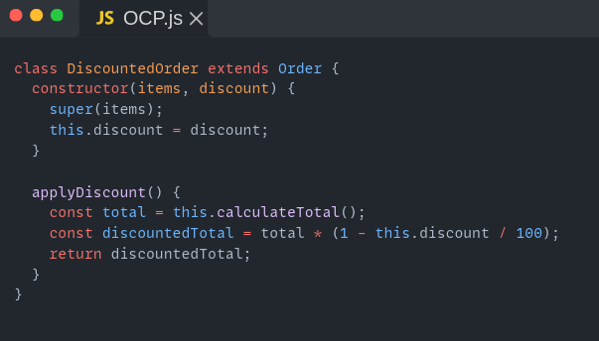
Open / Closed Principle
Solution

Slide 46
Liskov Substitution Principle
When extending a class, remember that you should be
able to pass objects of the subclass in place of objects of
the parent class without breaking the client code.
Notes:
In other words, if class B is a subclass of class A, you should be able to replace A with B without breaking any functionality or introducing unexpected behavior in the client code.
Suppose you have a DatabaseConnection class with a method openConnection(). Derived classes like MySQLConnection and PostgreSQLConnection should implement openConnection() so that any instance of DatabaseConnection can be used interchangeably in code without causing issues.

Slide 47
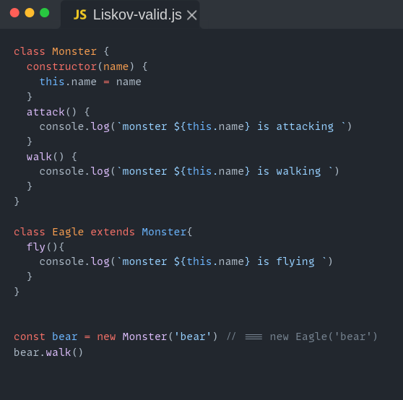
Liskov Substitution Principle
We can substitute Monster (base class) with Eagle (sub class)

Slide 48
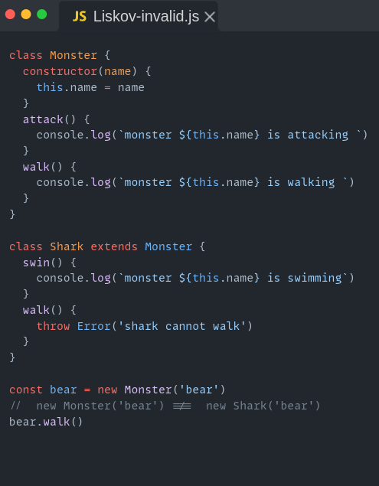
Liskov Substitution Principle
We can’t substitute Monster (base class) with Shark (sub class)

Slide 49
Interface Segregation Principle
Derived class shouldn’t be forced to depend on methods they do not use.

Slide 50
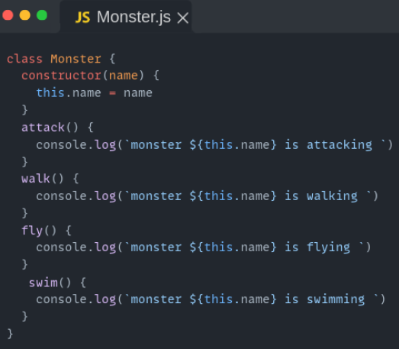
Interface Segregation Principle
Remember Monster example
you should break down “fat” Interface into more granular and specific ones.
Notes:
This violates the Interface Segregation Principle (ISP) because it forces all subclasses (monsters like sharks, bears, eagles, etc.) to implement methods they don't use. This creates unnecessary dependencies and makes the code harder to maintain and extend.

Slide 51
Dependency Inversion Principle
High-level classes shouldn’t depend on low-level classes. Both should depend on abstractions. Abstractions shouldn’t depend on details. Details should depend on abstractions.

Slide 52
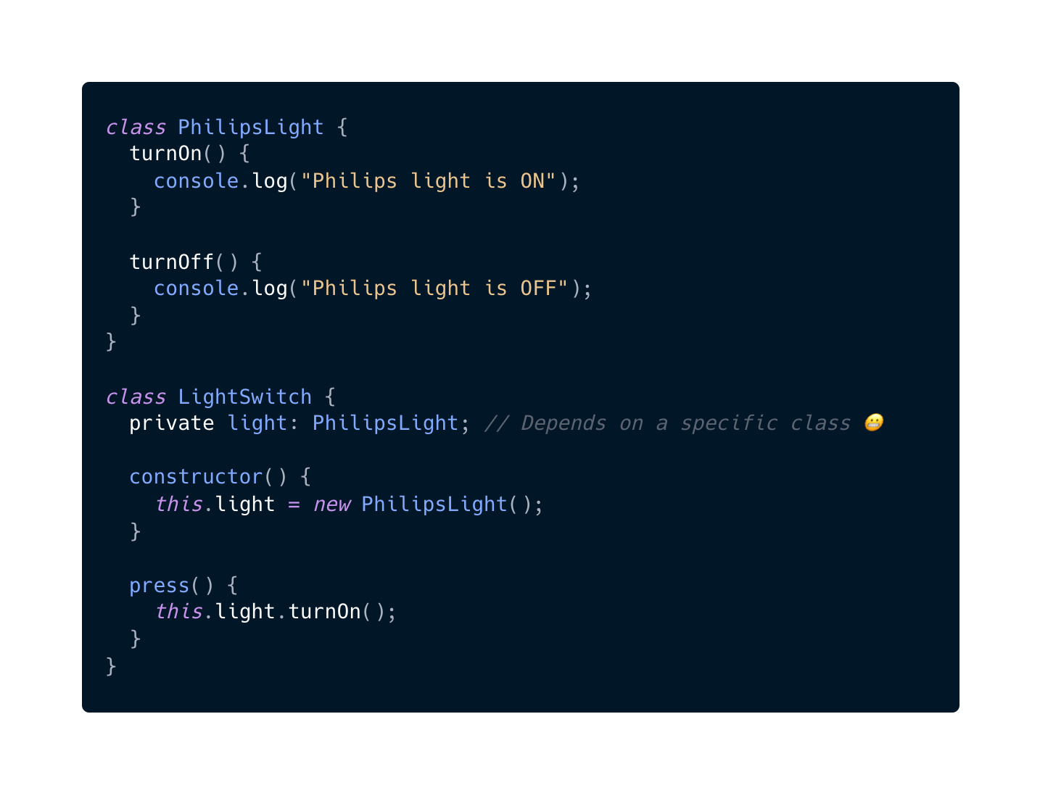
Dependency Inversion Principle
Is there a problem here ?
Notes:
What if we need to use Panasonic instead of Philips?

Slide 53
Dependency Inversion Principle
Light Switch
Philips
Light Switch
Panasonic

Slide 54
Dependency Inversion Principle
Philips
Light Switch
Light
Panasonic

Slide 55
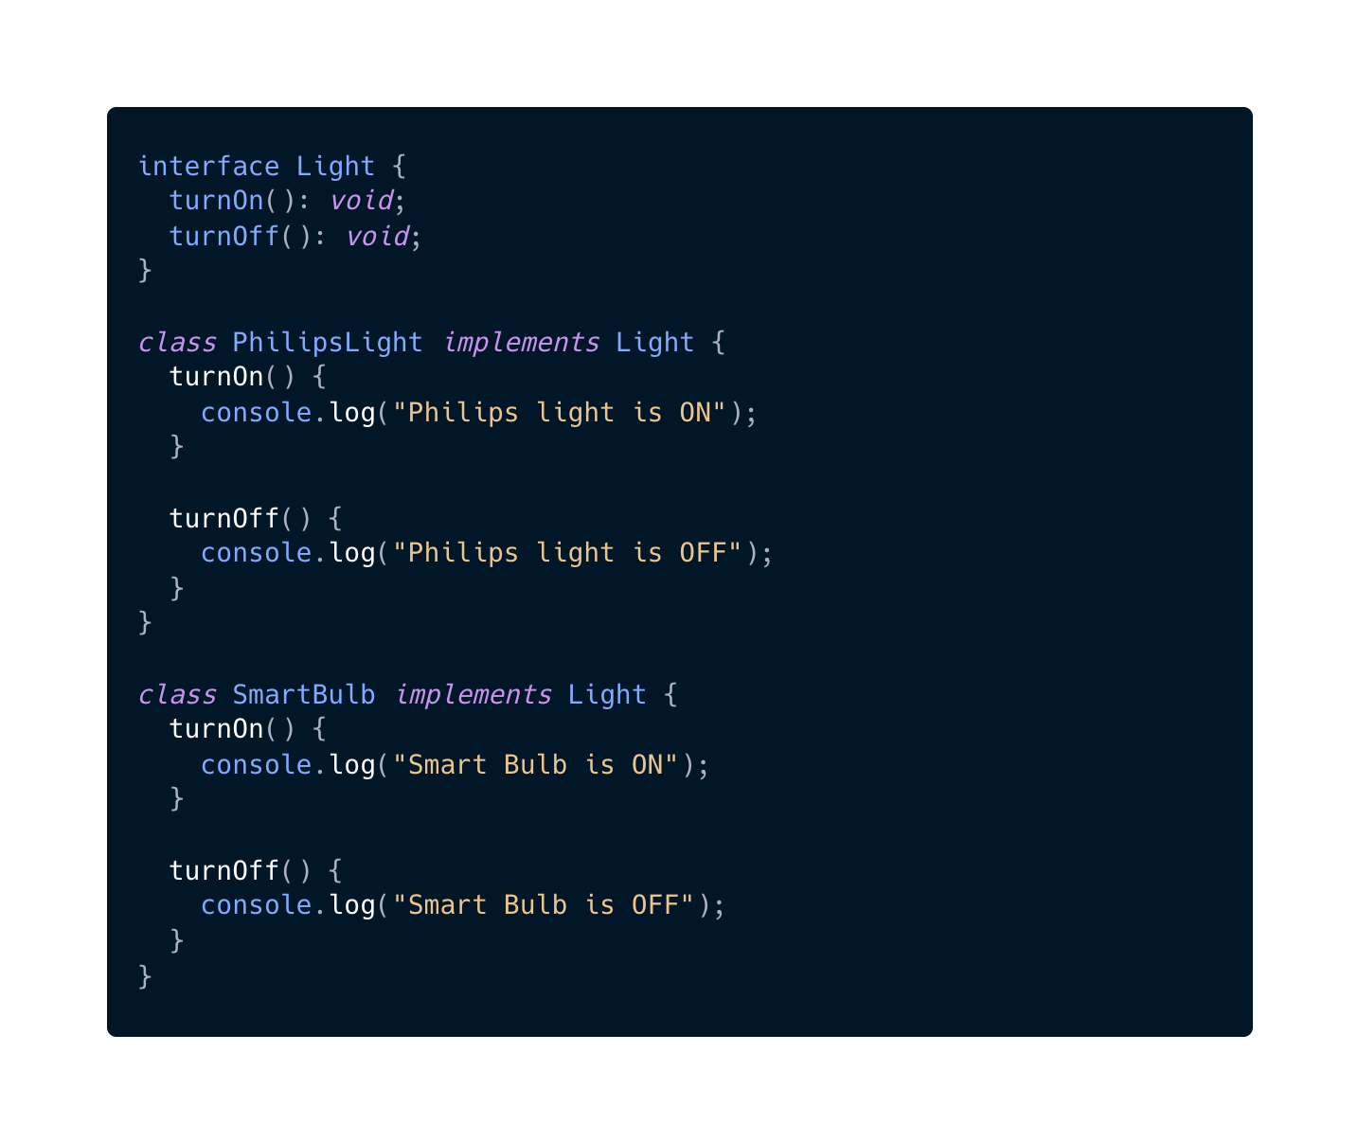
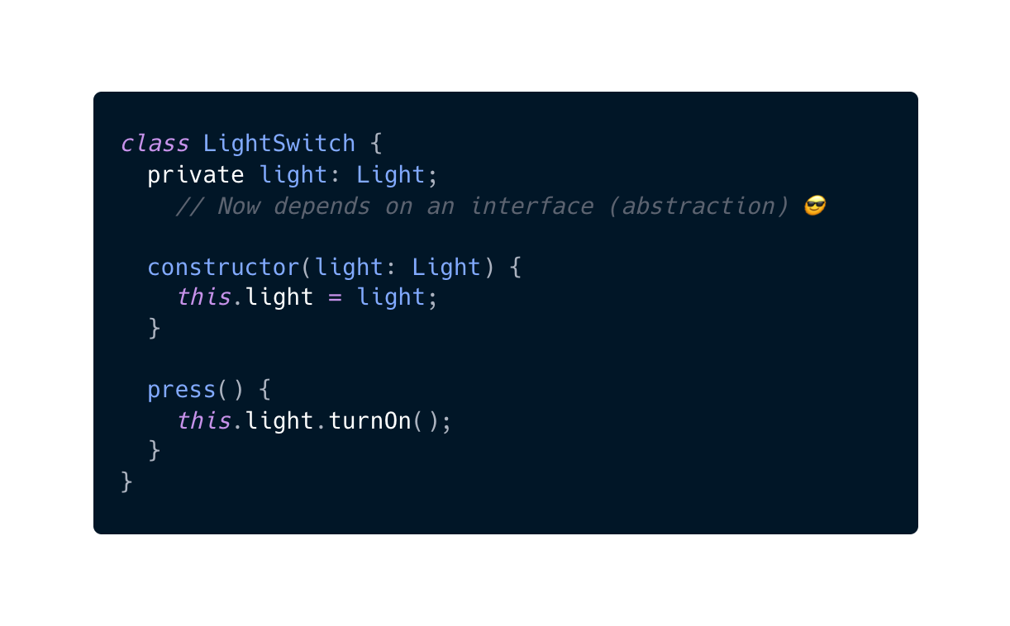
Dependency Inversion Principle

